Slide 1
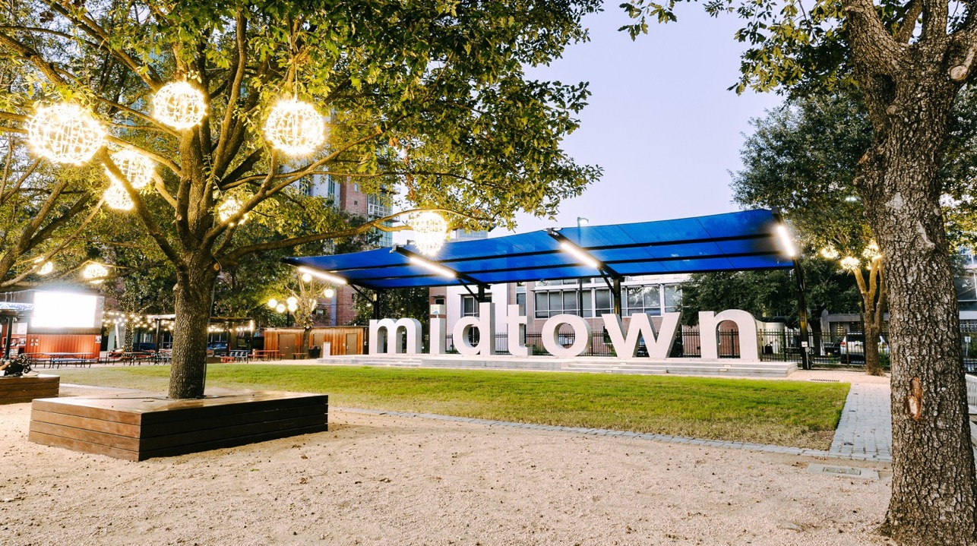

Midtown management district committee updates
July 2025

Slide 2
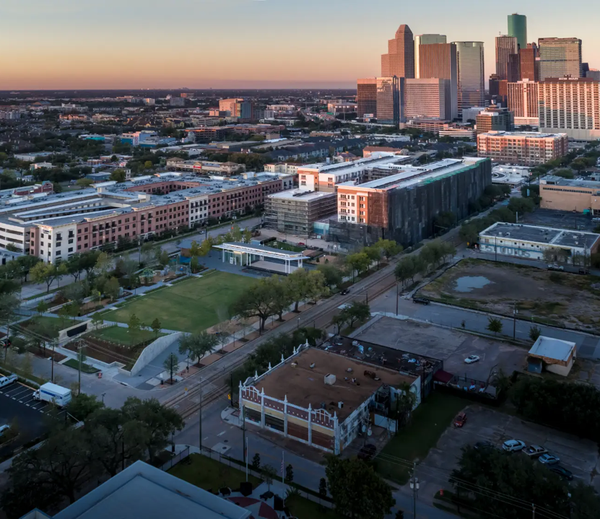
reports
Public Safety
Service & Maintenance
Economic Development
Marketing
Urban Planning
Parking Benefit District
Cultural Arts & Entertainment
Finance & Budget
Executive

Slide 3
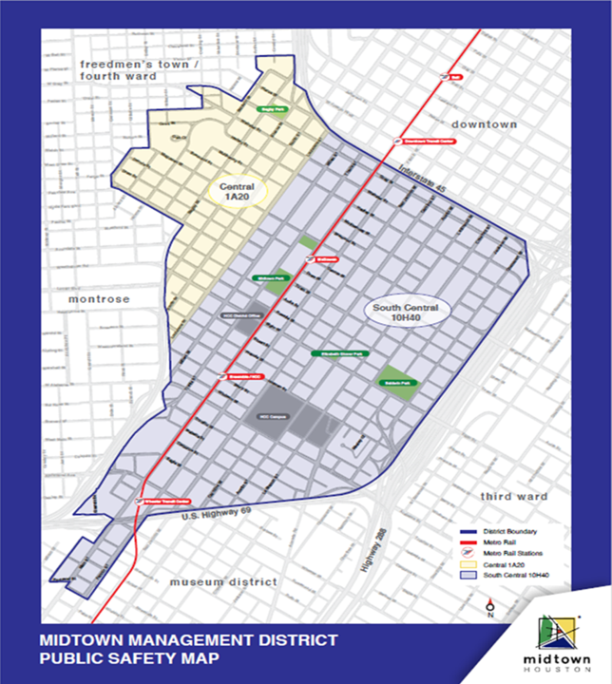
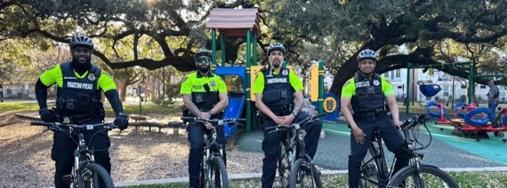
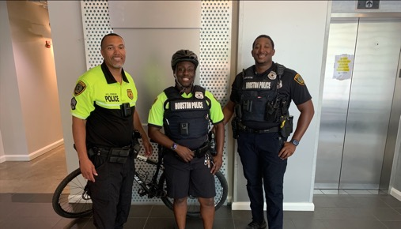

Slide 4
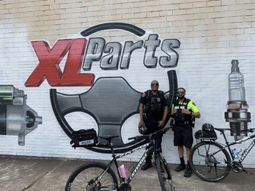
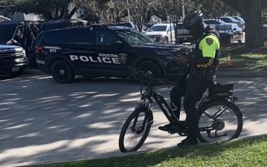
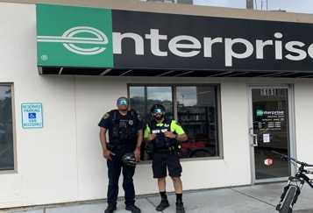
Midtown Bicycle Patrol Initiative
01-07-2025 thru 06-28-2025
HPD Central Division
Citizen Contacts: 612
Calls for Service: 10
BMV Report Card: 812
On-View Investigations: 163
ORI’s (Reports): 16
Citations Issued: 735
Arrests: 5
Trespass Warnings: 63
HPD South Central
Business Checks: 814
Calls for Service: 5
Charges: 1
Moving Violations: 1
ORI’s (Reports): 2
Accidents: 1
HFD Transport: 1
*Funded by Parking Benefit District*

Slide 5
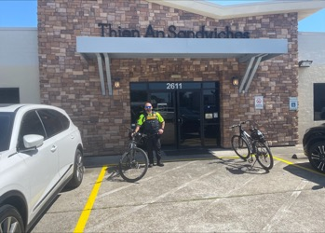
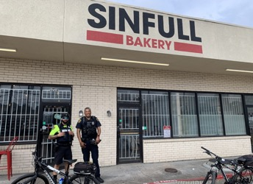
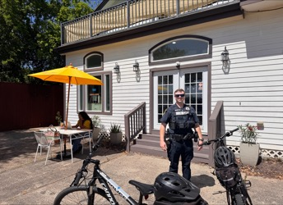
Midtown Violent Crime South Central
01-07-2025 thru 06-28-2025
Primary Calls: 46
Secondary Calls: 34
Offense Reports: 9
Crime Initiatives: 61
Citizen Contacts: 145
Felony Arrests: 11
Misdemeanor Arrests: 7
Trespass Arrest: 4
*Special Projects Funded*
Felony Charges: 9
Misdemeanor Charges: 7
Felony Warrants: 19
City Warrants: 135
Traffic Stops: 76
Moving Citations: 3
Weapons Seized: 2
Narcotics Seized: 4

Slide 6
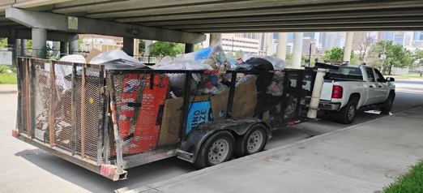
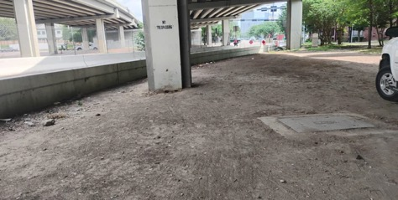
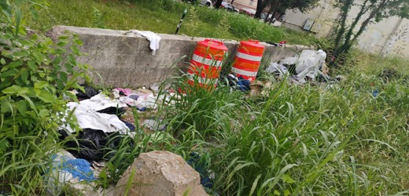
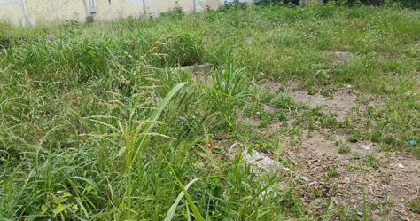
Midtown targeted cleanup initiative
July 2025
Spur 527
3200 San Jacinto

Slide 7
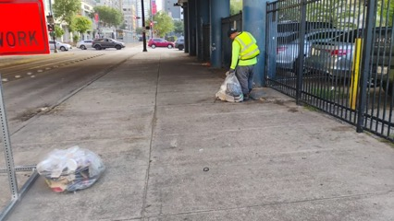
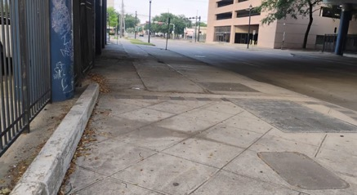
Midtown targeted cleanup initiative
June 2025
Midtown District Targeted Cleanup with HPD
Locations:
Pierce Elevated
1100 Francis
1100 Winbern
800 - 1100 Hadley
Spur at Milam
4900 Main
3200 San Jacinto
Pierce Elevated

Slide 8
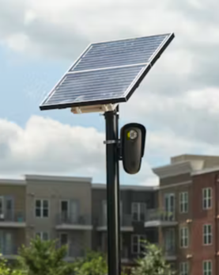
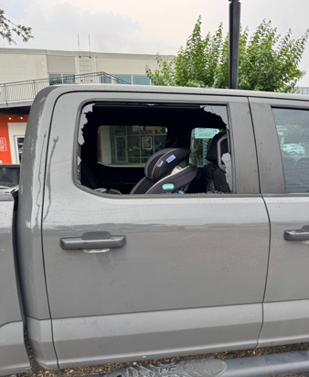
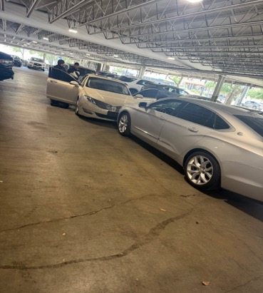
Public Safety through Partnership: MidTown Houston and Law Enforcement

Slide 9
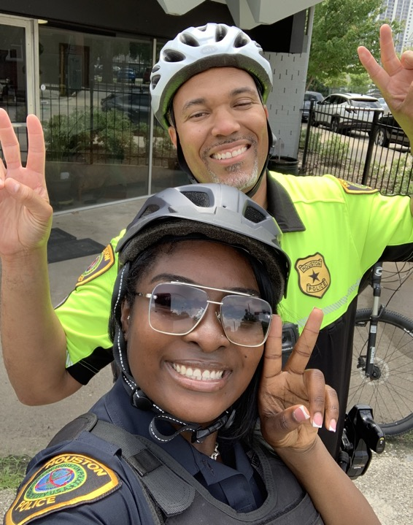
Public safety
Public Safety Committee
July 15, 2025
11:30 a.m.

Slide 10
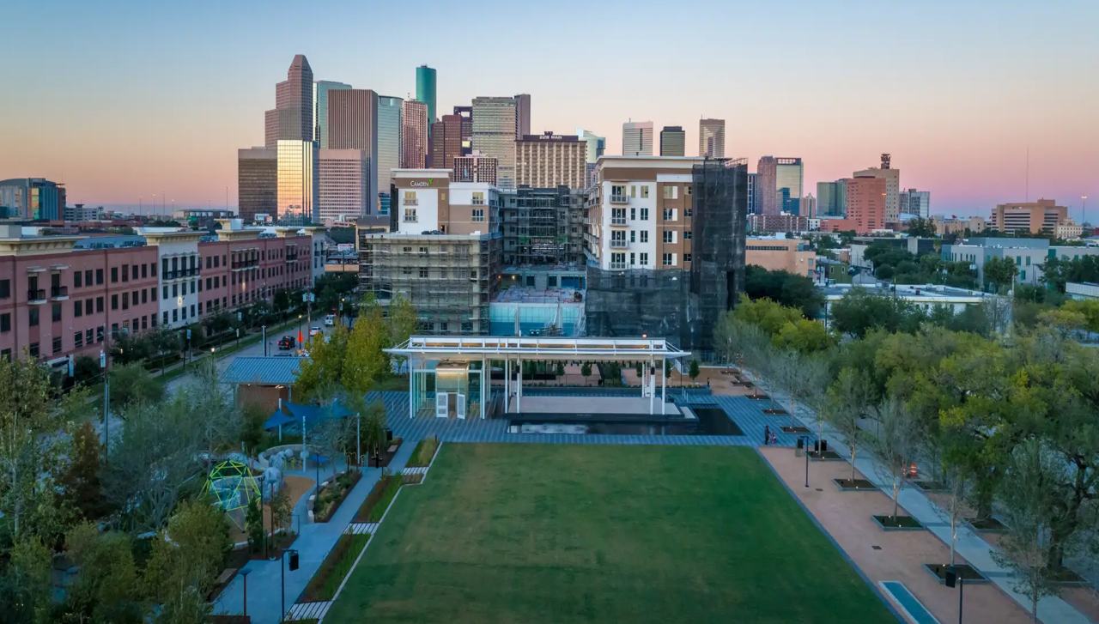
Service and maintenance

Slide 11
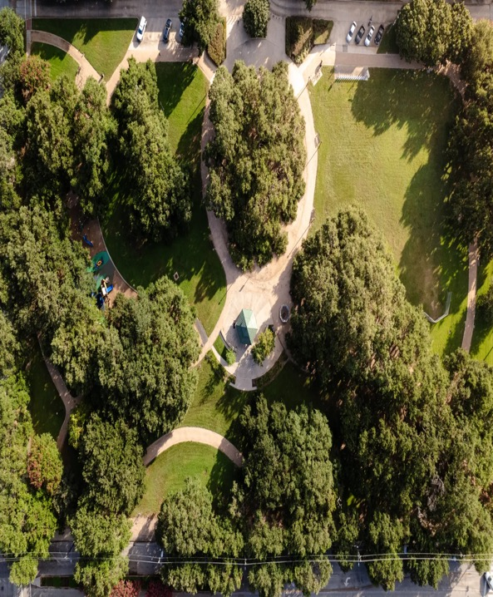
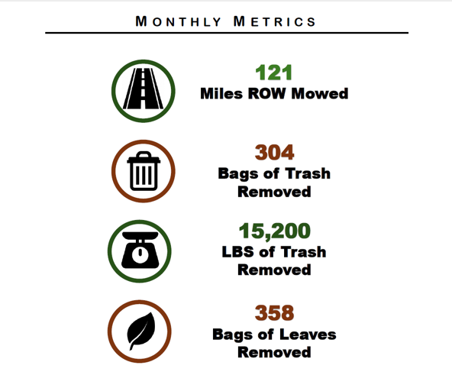
FIELD SERVICE TEAM & MAINTENANCE MONTHLY UPDATE

Slide 12
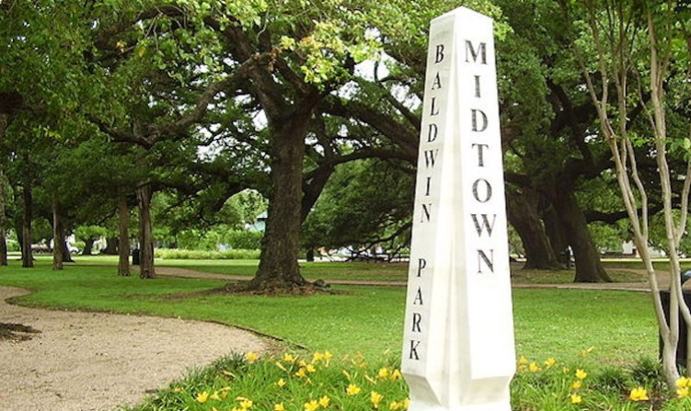
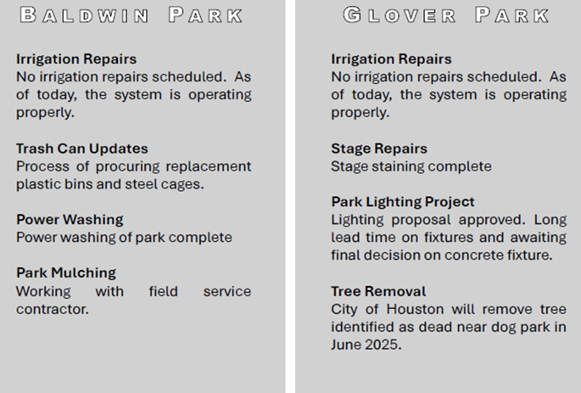
Park maintenance
PARK MAINTENANCE

Slide 13
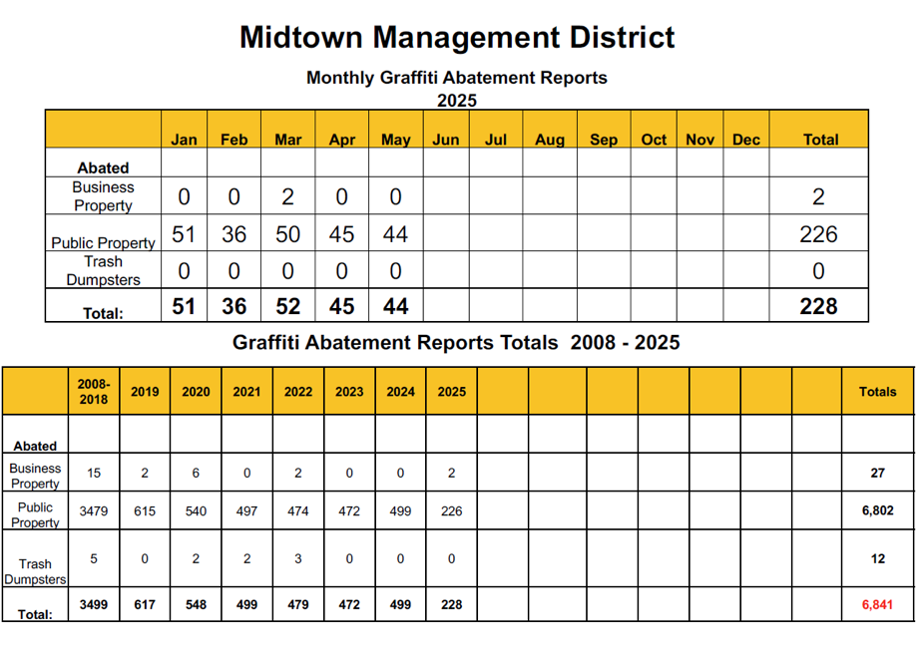

Slide 14
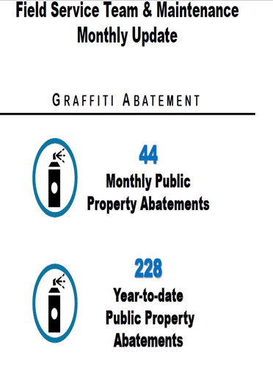


BEFORE
AFTER
400 GRAY
2400 BAGBY

Slide 15

SEE-CLICK-FIX
Midtown staff received 1 graffiti abatement report
  Report was acknowledged and information was sent to graffiti abatement vendor for completion in June 2025
Midtown staff received 1 traffic report
  Report was acknowledged 311 ticket will be created as this is a City of Houston traffic issue
  Midtown has no jurisdiction on roadway design or enforcement

Slide 16
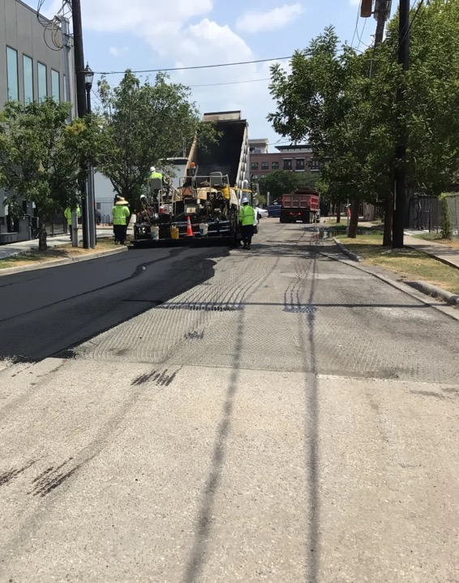
Sidewalk assessment & repair
Project focused on small sidewalk panel replacements (20 ft or less)
Larger projects are deferred to MRA’s sidewalk program
$65,000 will be allocated under the urban planning special projects
Midtown staff are waiting for the updated cost breakdown of the project
Final work anticipated to start after the City of Houston project is completed

Slide 17
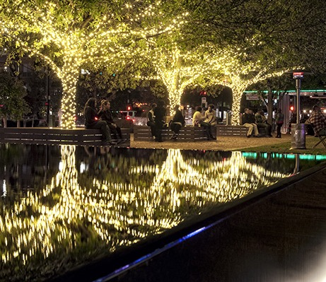
DARK BLOCK OPPORTUNITIES
CenterPoint Energy’s revised 52-light plan was approved by the city; awaiting formal agreement for execution
Pedestrian lighting study: proposed initial phase exceeds current $30K planning budget
Potential reallocation of Urban Planning special projects funds ($165K total)
Discussion on involving Midtown Redevelopment Authority for co-funding

Slide 18
CITY OF HOUSTON AGREEMENT/Tri-Party Agreement
CITY OF HOUSTON MAINTENANCE AGREEMENT
The agreement remains under review by the City of Houston for preparation to submit for the city council approval
TRI-PARTY AGREEMENT
Legal counsel is drafting a formal transition plan to dissolve the existing agreement
Midtown staff is reviewing scope of services currently covered under the Tri-Party agreement to prepare for internal management
Key item under consideration: Main Street Esplanade maintenance (currently under METRO contract, expected to expire in 2025)
Plan will be finalized after reviewing updated COH expectations and resource needs.

Slide 19
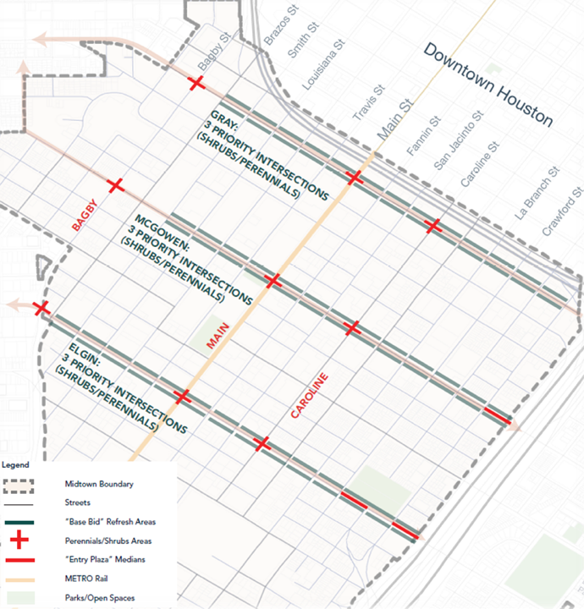
Midtown streetscape refresh
Streetscape improvement work is underway on Elgin and McGowen Streets
  Demo and irrigation repairs completed
  New plant materials being installed
Proposal to reallocate $300,00 from Gray Street improvement project is on hold due to METRO/COH construction to Main and Bagby Streets
Board approval required for construction phase service contracts:
  Construction Management and Inspection – IDS Engineering Group
  Construction Administration – Walter P. Moore

Slide 20
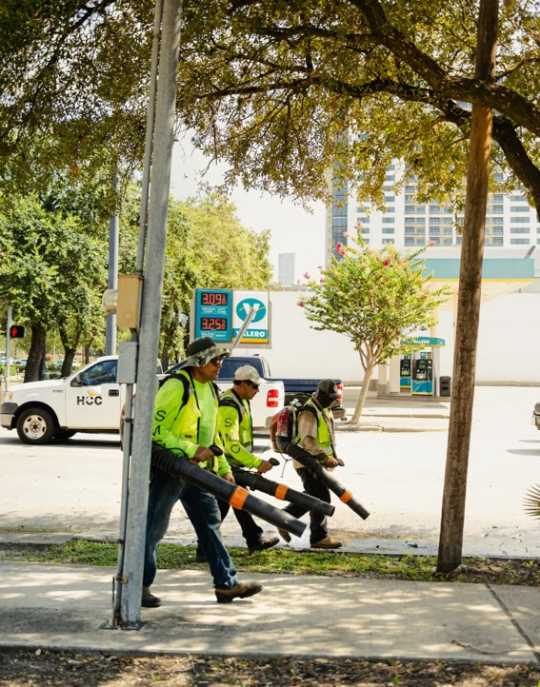
Service and maintenance
SERVICE AND MAINTENANCE COMMITTEE
July 21, 2025
4:00 P.M.

Slide 21
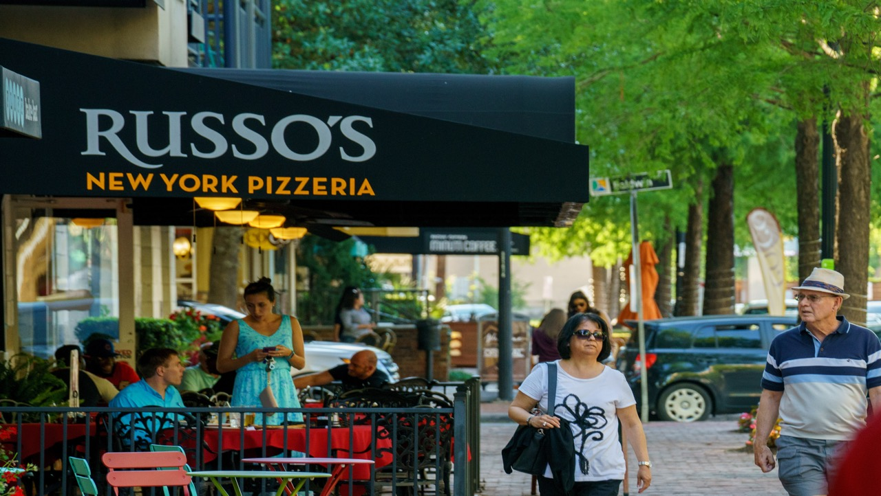
ECONOMIC DEVELOPMENT

Slide 22
ECONOMIC DEVELOPMENT
Midtown Camera Grant Pilot Program
Purpose: To reduce crime and support community businesses through surveillance and deterrence
Pilot Program Details:
  Midtown would purchase the installation of cameras and cover 6 months of service
  Post-pilot, business owners decide to continue service
  Grant participation requirements will be discussed among the committee and presented in an upcoming meeting
  Pilot budget proposed for 5 camera installations, with site selection based on business need and public safety input

Slide 23
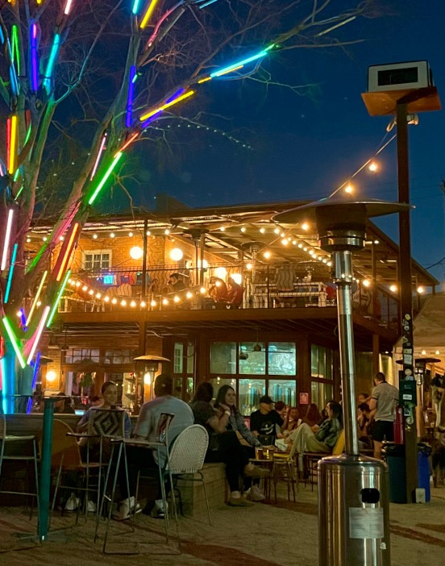
Economic development
ECONOMIC DEVELOPMENT COMMITTEE
July 16, 2025
10:00 A.M.
Location: TBA

Slide 24
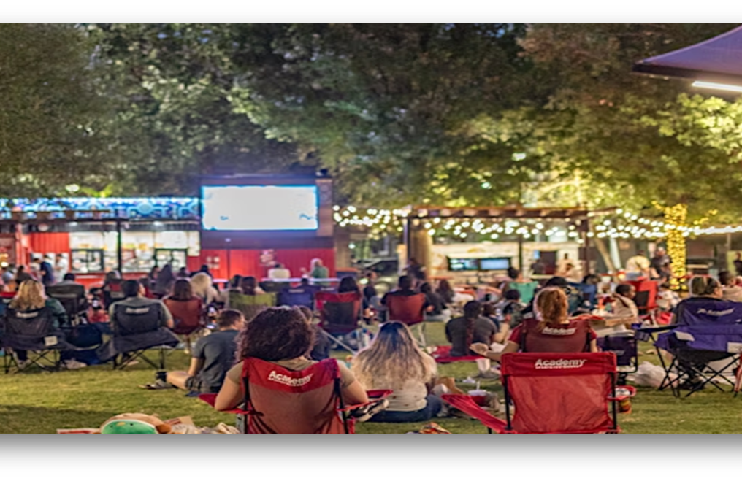
marketing

Slide 25
Communications Report MAY 2025

Slide 26
COMMUNICATIONS REPORT APRIL 2025

Slide 27
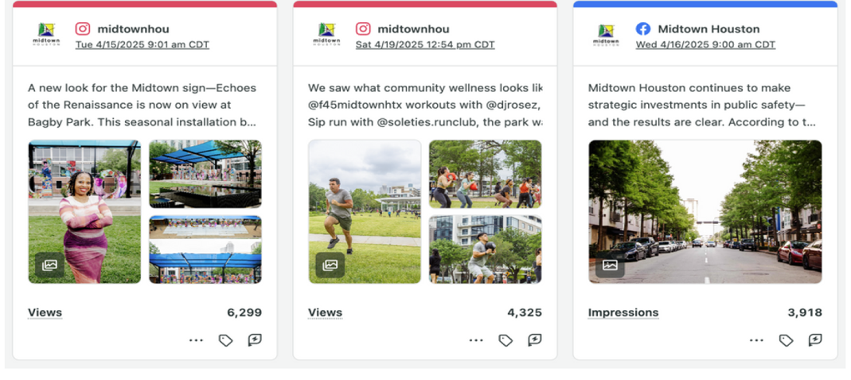
Communications report April 2025
TOP POST BY IMPRESSIONS

Slide 28

marketing
MARKETING COMMITTEE
July 15, 2025
3:00 P.M.

Slide 29
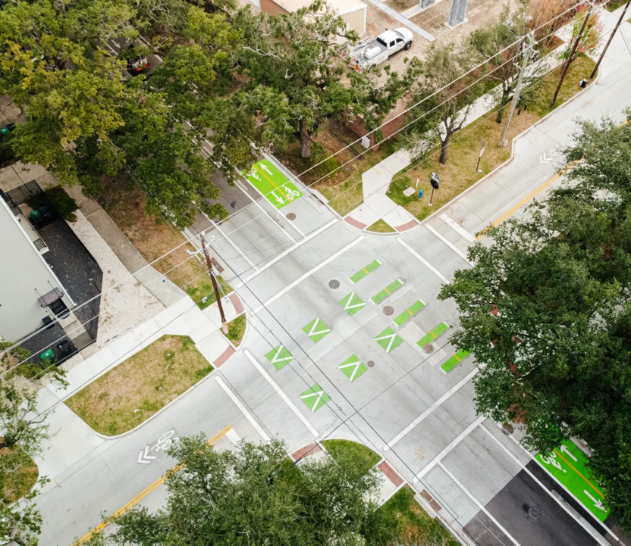
Urban planning

Slide 30

GRAY STREET BIKEWAY ENHANCEMENTS
Construction scheduled to begin in June 2025
AUSTIN STREET BIKE LANE
Presentation by BikeHouston at June 2025 board meeting
No formal letter of support has been issued
Additional Board education and presentations are planned before taking action
Work will begin on segments not affected by the Austin Street COH construction project (starting along LaBranch and side segments
Construction Phase Services contracts Construction Management and Inspection – IDS Engineering Group
Construction Administration – Walter P Moore
Construction Phase Services contracts

Slide 31
Pedestrian Lighting Assessment Proposal
Consultant proposal outlines a multi-phase approach:
  Phase 1:
Existing Conditions Assessment, Community Night Walk, Nighttime Vulnerability Assessment, Estimated Cost: ~$30K+
  Phase 2:
Stakeholder Engagement, Development of Master Plan
  Phase 3:
Final Implementation Planning, Construction Documentation
Urban Planning Committee
Gray Street Bikeway Enhancements -

Slide 32
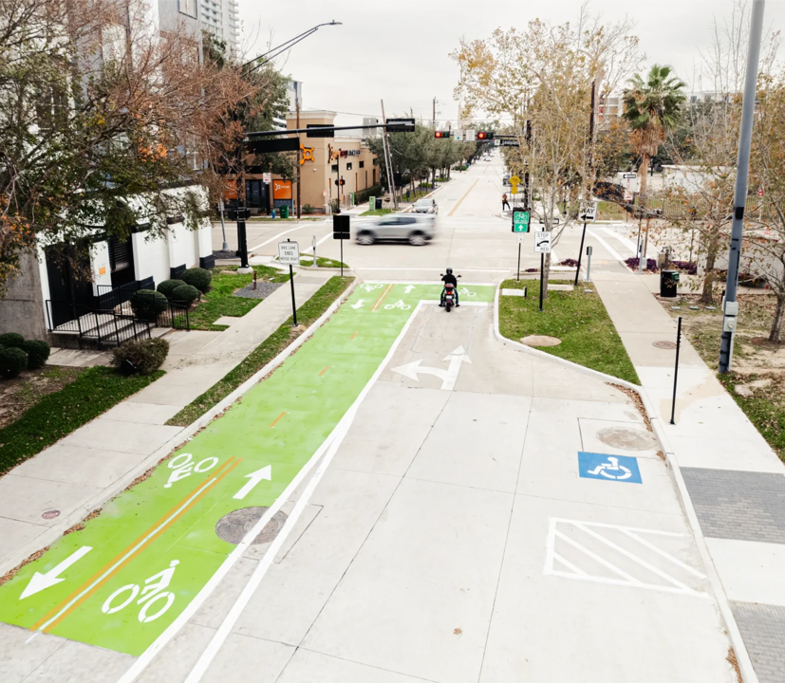
URBAN PLANNING COMMITTEE
July 21, 2025
4:00 P.M.

Slide 33
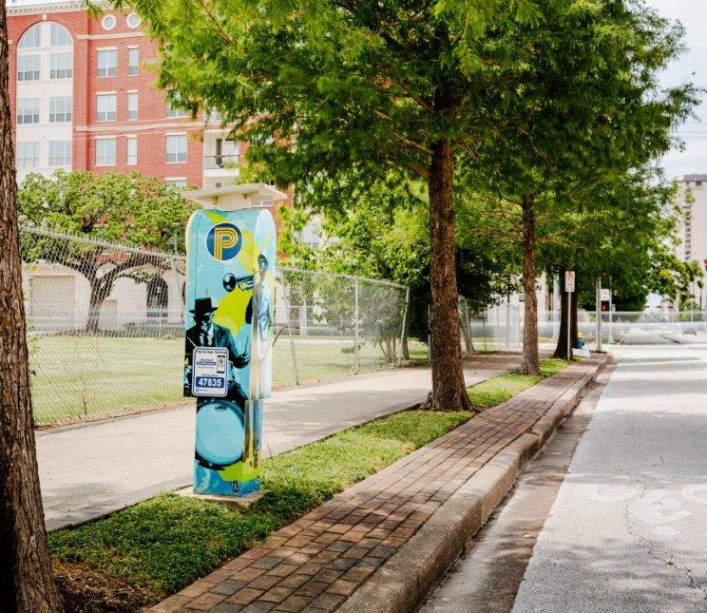
Parking benefit district

Slide 34
Parking benefit district
Committee approved recommendation of the following proposals:
  HPD Central Division Loud Noise Reduction Initiative $31,264.00
  Houston Police Department Central Division’s Midtown Traffic and Parking Initiative $41,480.00
  Houston Police Department Central Division Vagrant & Property Crime reduction Initiative $60,810.00
    Initiative will permit officers to alternate bike and vehicle patrols
  Houston Citizens’ Police Academy Alumni Association Hydrate the Officers Proposal
    10 pallets of bottled water for HPD officers at $1,800.00
  Total approved funding for all proposals: $135,354.000

Slide 35
Proposal that was tabled to the next parking benefit district advisory committee meeting:
    Houston Police Department Central Division’s Midtown Bar and Club Inspection Initiative $20,270.00
    Proposal to inspect bar & club compliance (permits, fire safety, TABC licensing)
Current estimate funding projected in July 2025 is $190,000.00
Remaining balance estimated at less than $40,000.00 subject to adjustments after the speed feedback study project cancellation
$14,142.78 was allocated to the HPD South Central Division for 6 traffic control laser devices
Midtown staff will follow up with HPD Central Division for additional project proposals

Slide 36
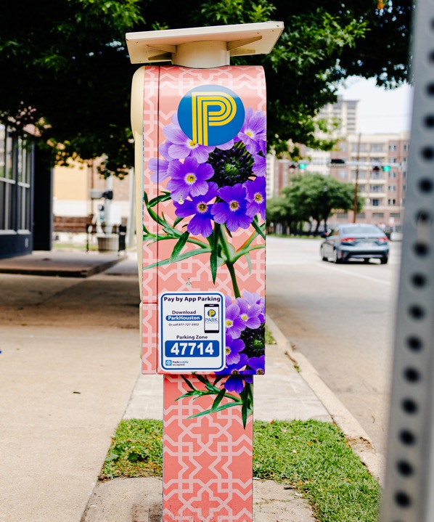
Parking benefit district
PARKING BENEFIT DISTRICT ADVISORY COMMITTEE
September 11, 2025
3:00 P.M.

Slide 37
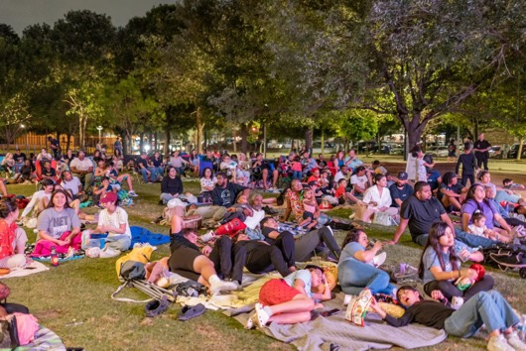
Cultural arts and entertainment

Slide 38
Hueman: shelter bloomberg public art challenge project
Artist Announcement: On May 20, 2025, the project team officially launched the featured artists for HueMan: Shelter across multiple platforms including:
A press release
Social media announcements via HueMan: Shelter and Midtown accounts
Artist profiles published on the HueMan: Shelter website
First edition of the HueMan: Shelter newsletter distributed
Article published on the Midtown Houston website
* Funded by the Bloomberg Public Art Challenge Grant*

Slide 39

Cultural arts Master plan
New 5-year Cultural Arts Master Plan funded by the Houston Endowment
Involves interactive public art planned for Midtown parks
Plan will align with the City of Houston initiatives
RFQ release expected within 60–90 days; RFP to follow after release
Community input will be sought to shape the future of arts in Midtown

Slide 40
Houston endowment grant
The team is preparing the cycle report for the current Houston Endowment grant
Simultaneously, work has begun on preparing the application for the next grant cycle to continue funding cultural arts and community engagement programs in Midtown
Advocacy Involvement:
Midtown representatives participated in the launch of the new advocacy platform (QR.org) to support continued and increased arts funding citywide
This includes sharing Midtown’s successes and promoting future opportunities through strategic partnerships
*Funding from this grant also supports MidtownHOU Arts Micro Grants, public art installations, and elements of the Cultural Arts Master Plan 2025*

Slide 41
2025 Midtownhou Arts micro grants
Funded through the Houston Endowment, the microgrant program provides small-scale funding for local artists and creative to implement cultural and community-building projects in Midtown
Project Completion: As of May 2025, 50% of grantees have completed their approved projects
The remaining grantees are scheduled to deliver events or installations in Q3 and Q4 2025
Promotion and Visibility:
    Completed projects are featured on the Midtown Houston website’s community events page, ensuring public access and visibility
    Midtown plans to continue promoting these projects through newsletters, social media, and printed guides

Slide 42
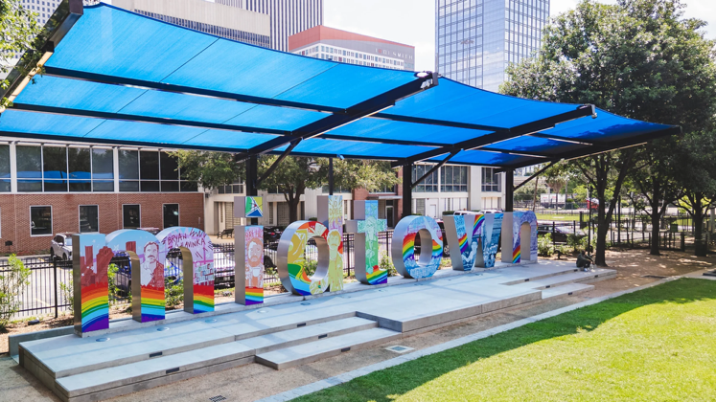
Pride Month Sign Wrap
Pride Month sign wrap was installed May 30, 2025
Sign wrap on view through mid-July 2025

Slide 43
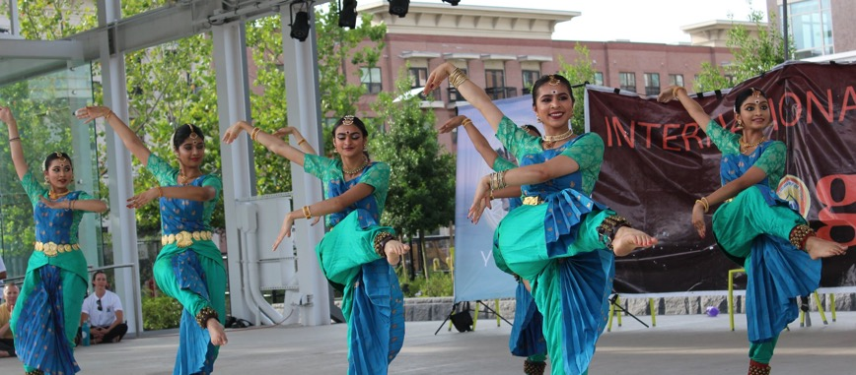
CULTURAL ARTS AND ENTERTAINMENT
CULTURAL ARTS AND ENTERTAINMENT COMMITTEE
July 15, 2025
3:00 P.M.

Slide 44
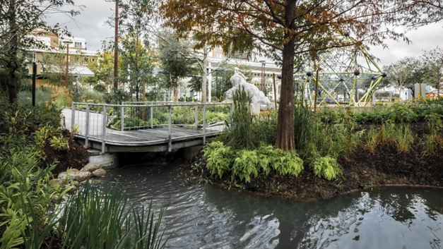
Finance & budget
FINANCE & BUDGET COMMITTEE
July 29, 2025
1:00 P.M.

Slide 45

executive committee
All Matters Discussed At The Executive Committee Meeting Were Addressed In The Various Committee Activity Reports

Slide 46
Midtown Management District Board of Directors Meeting
August 6, 2025
6:00 P.M.
410 Pierce Street (at Brazos) 1st Floor
Houston TX 77002

